Slide 1
3rd team
Kocsis András Barnabás, Kórodi-Juhász Dávid Attila, Petz Dávid

Slide 2
The Project’s vision
We have a client
Creating a webshop
Making the client’s work easier
Easy to use for the users and easy to modify for the client
Traditional handmade products
Multi language site

Slide 3
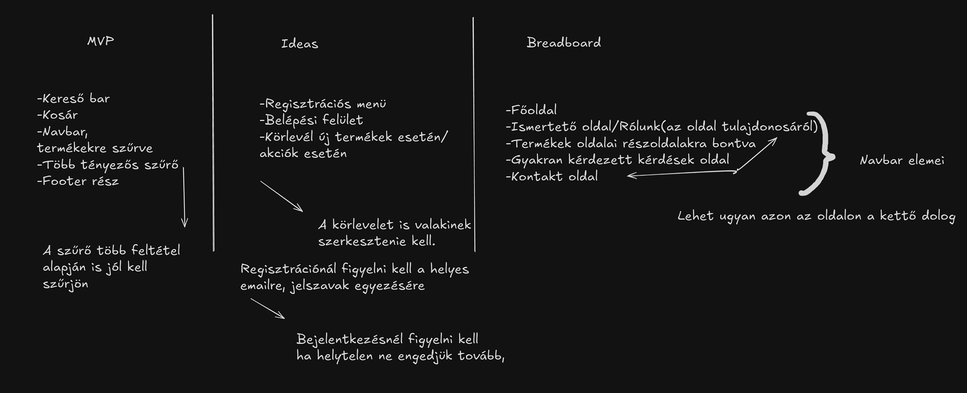
Ideas and planning

Slide 4
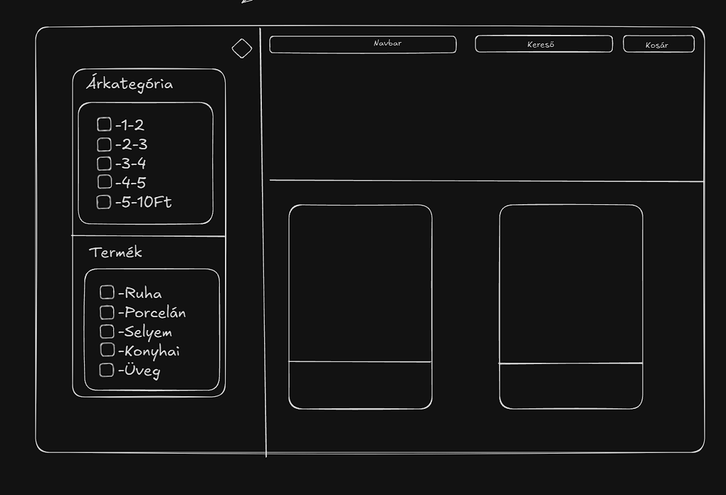
Ideas and planning

Slide 5
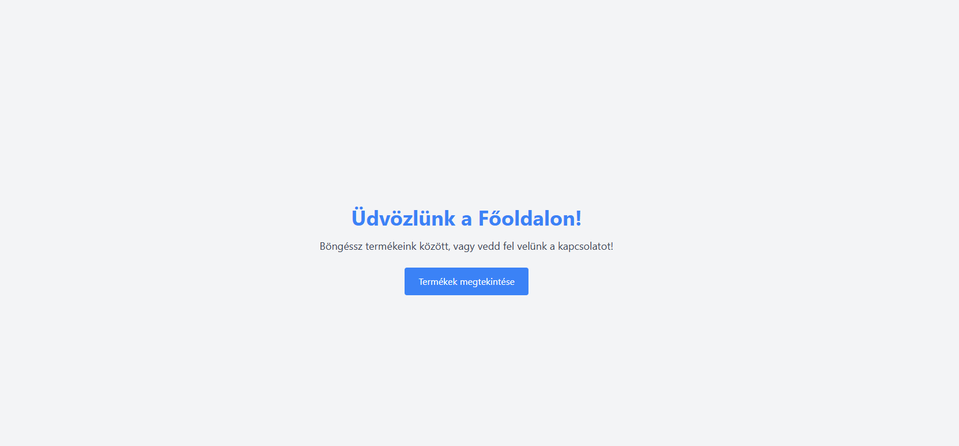
Welcome page (for now)

Slide 6
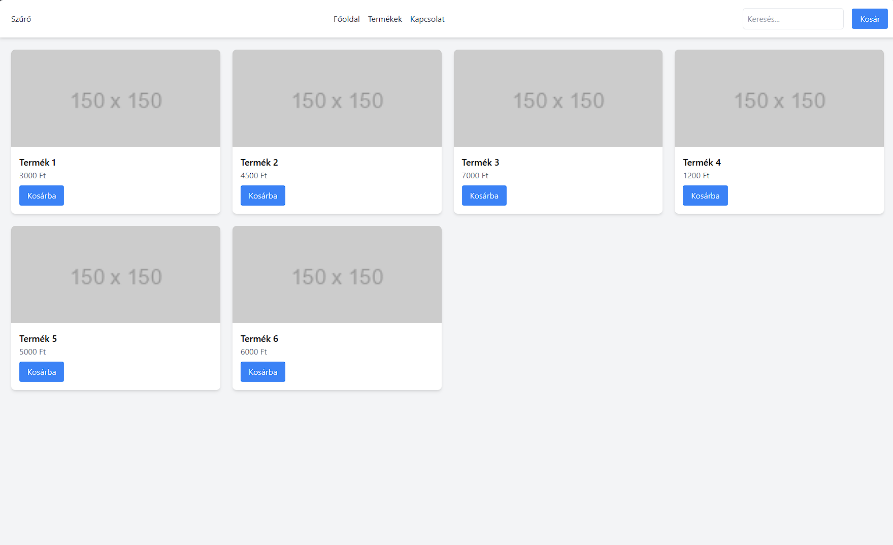
„Products” page

Slide 7
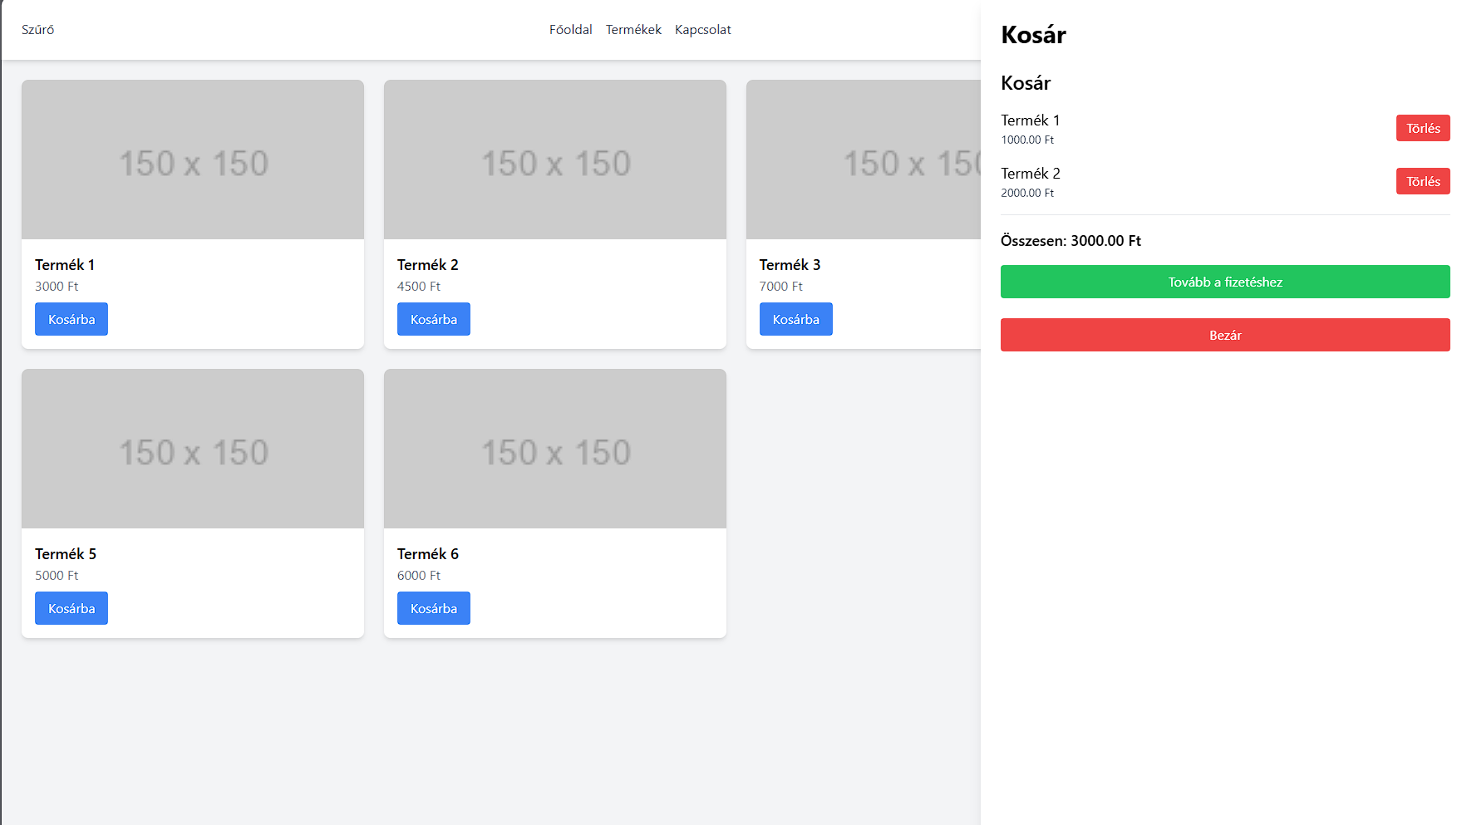
„Products” page

Slide 8
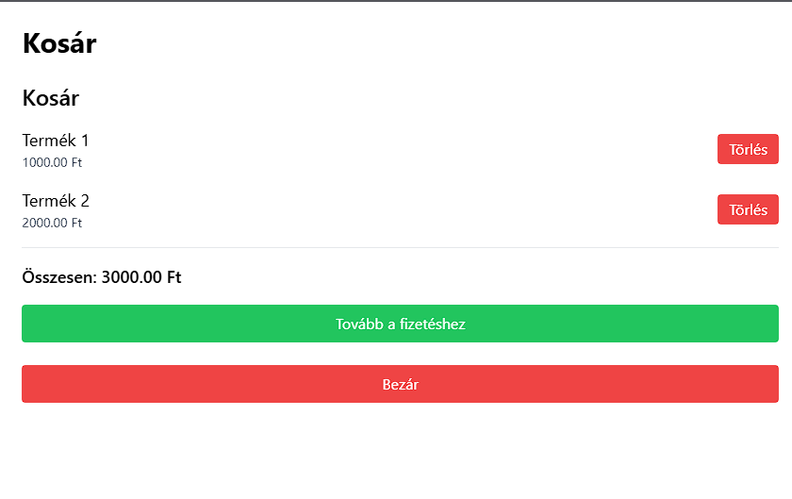
The Basket

Slide 9
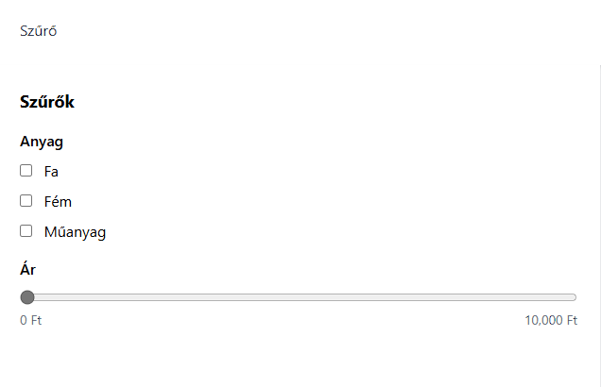
The Filter

Slide 10
The Navbar

Slide 11
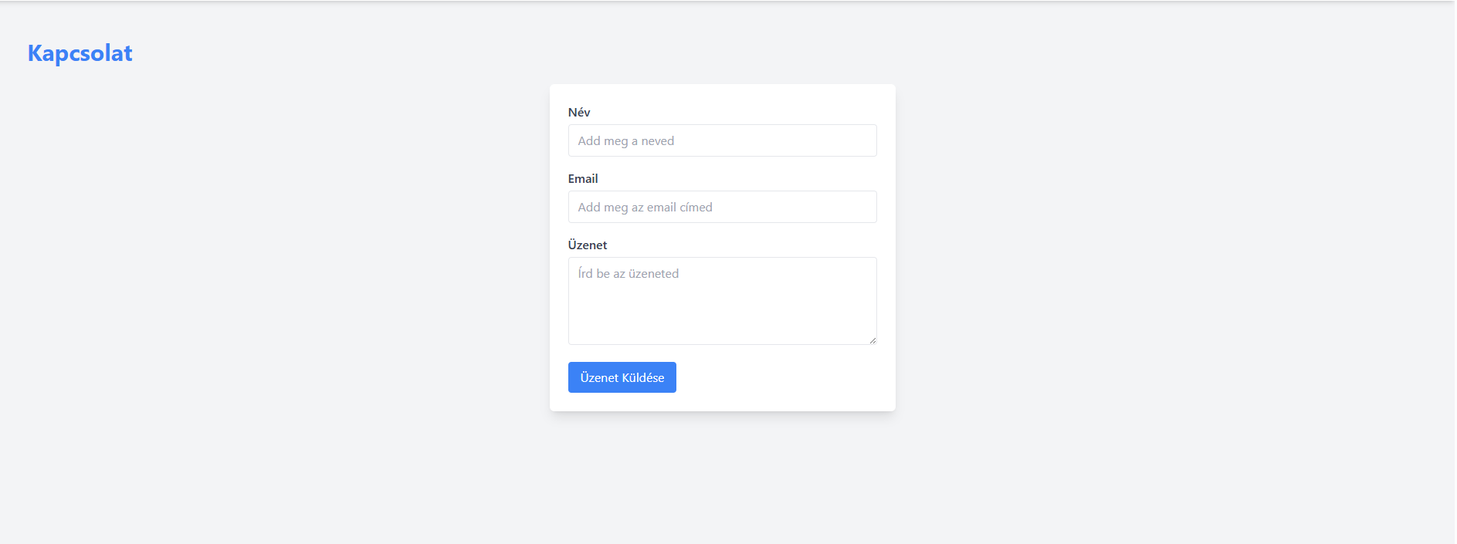
„Connection”page (for now)

Slide 12
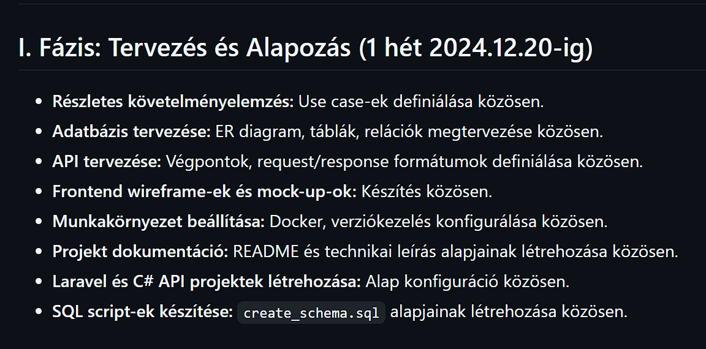
Project phases

Slide 13
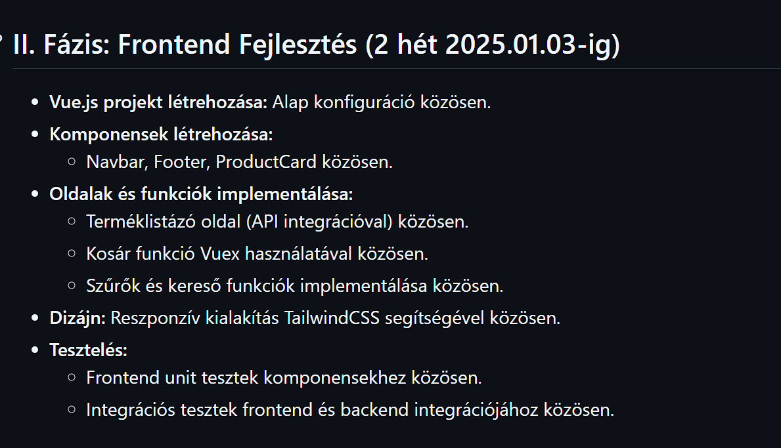
Project phases

Slide 14
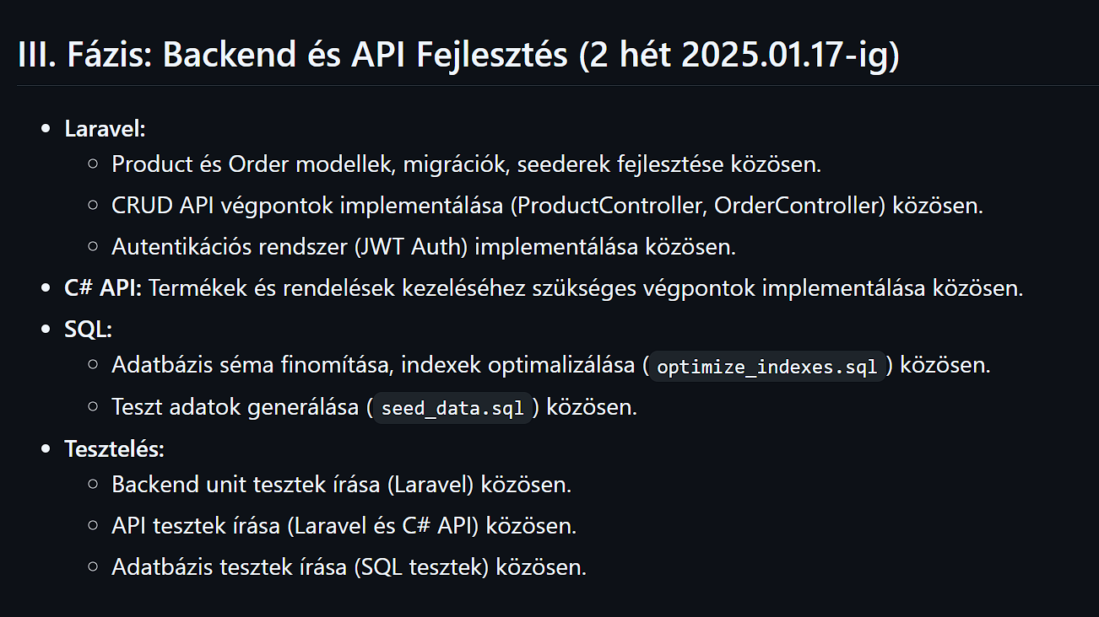
Project phases

Slide 15
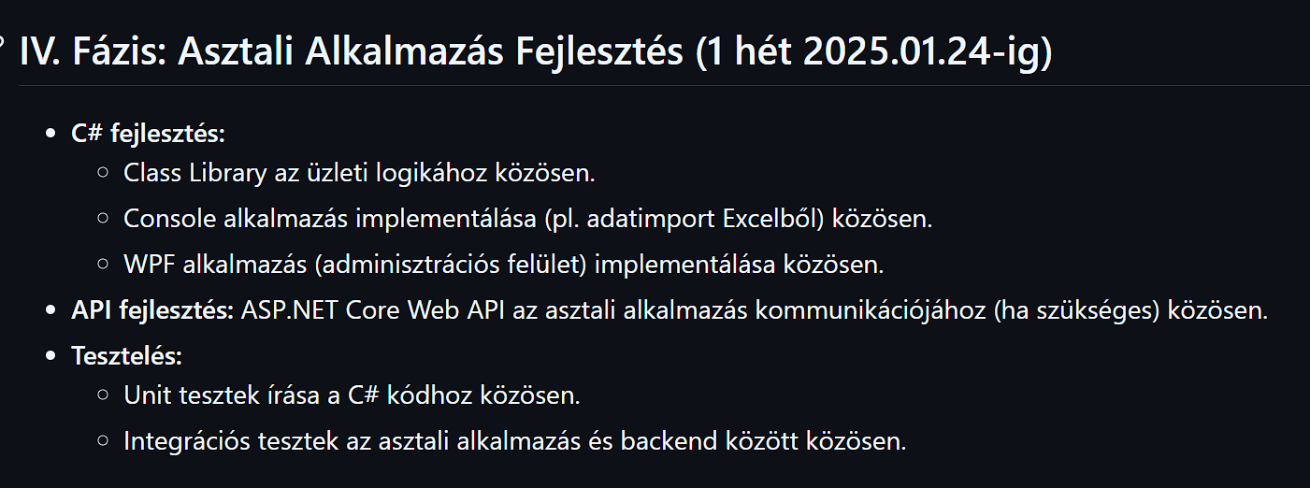
Project phases

Slide 16
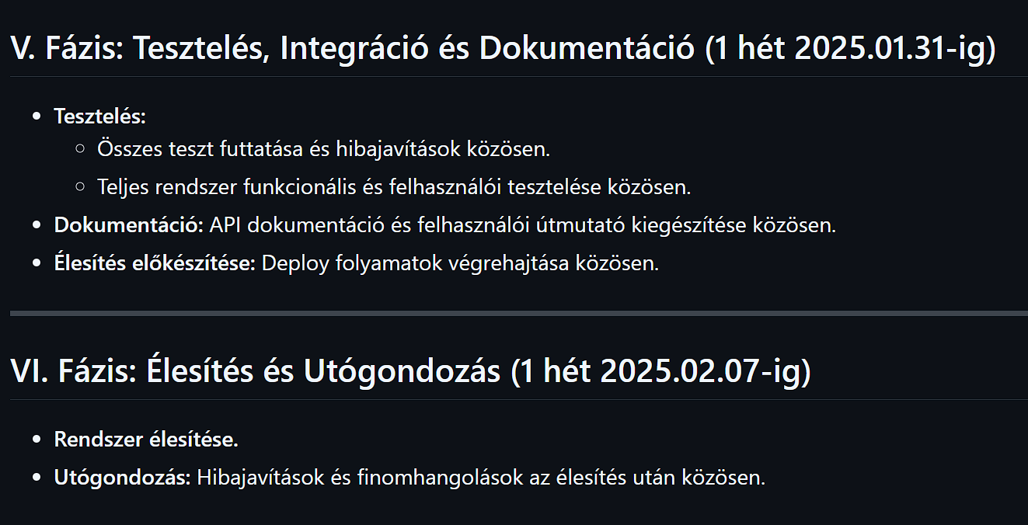
Project phases

Slide 17
Platforms where we work
Discord: primary use, call meetings, quick exchanges and talks about the project
Clickup: planning, giving out tasks
Github: uploading codes and commit for traceability

Slide 18


